Slide 1
Multi task learning and multi view learning

Slide 2
Multi-task learning (MTL) is a machine learning or deep learning paradigm in which a single model is trained to solve multiple related tasks simultaneously, leveraging shared representations and knowledge transfer to enhance efficiency and generalization across all tasks involved.
MTL works by learning shared features and representations in a common architecture, usually neural networks, so information gained from one task can assist with others. For example, in computer vision, a model may jointly learn to detect objects, segment images, and classify scenes, each task helping the others by providing richer shared features. This can improve prediction accuracy, data efficiency, and mitigate overfitting

Slide 3
The foundational idea is that related tasks have underlying commonalities that can be exploited through shared layers or representations.
The model may use different loss functions for each task and optimize them together, sometimes using weighting schemes to balance their influence.
Practical Applications:
Computer vision: Simultaneous object detection and segmentation.
Natural language processing: Joint sentiment analysis and topic classification

Slide 4
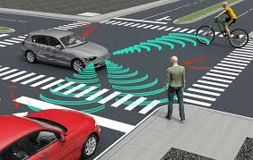
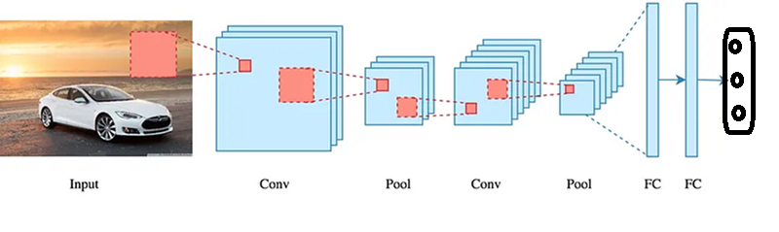
Example: Consider the case where the automated cars require object detection in the go.
A typical multi-task model for this scenario uses a shared convolutional neural network (CNN) backbone to extract general features from the camera images.
The output it would have to detect may be
Object detection (bounding boxes and class labels for cars)
Traffic light detection and recognition
3. Pedestrian and cyclist detection
Here we can think of a CNN model
cars
Traffic light
Pedestrian

Slide 5
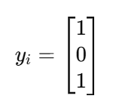
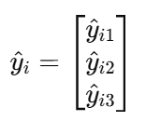
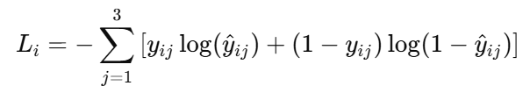

If in a single image you have a car and a pedestrian but not a traffic light then in that case the input xi is your image and the yi be
Now the output vector will be
Error for each sample will be
Total error to be
minimized is

Slide 6
Multi-view deep learning models are advanced neural architectures designed to integrate diverse perspectives or data sources to create richer, more robust representations for various learning tasks.
Architecture: Typically consists of separate sub-networks (e.g., CNNs, RNNs) specialized for each view. The features extracted are fused by methods such as early fusion (integrating at input or shallow layers), late fusion (combining outputs or embeddings),
3D Object Detection Using Multi-View Deep Learning
In 3D object detection, the goal is to accurately recognize and localize objects in three-dimensional space. Traditional single-view approaches, which rely on one perspective, often struggle with occlusions and pose variations. Multi-view deep learning addresses these challenges by leveraging multiple camera views or sensor modalities to capture complementary information.

Slide 7
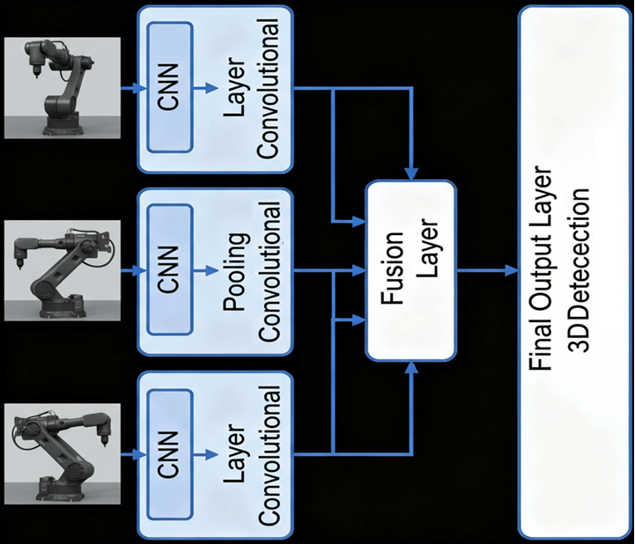
Input: Multiple 2D images captured from various fixed viewpoints around a 3D object
View-Specific Feature Extraction: Each image is processed by its own convolutional neural network branch that extracts view-specific features.
Final classification layers predict the object category

